Slide 1
COVID IN NIGERIA
Distribution, death rate AND effect on the gdp
Summary

Slide 2
COVID DISTRIBUTION
Lagos State was the most affected by COVID with the highest number of confirmed cases (104,157) which is more than 3 and a half times the second highest, Kano State and also holds the highest number of deaths(771).
There were over a quarter million confirmed COVID cases nationwide(266,138) and 3155 deaths
Kogi State had the lowest number of confirmed cases(5) and deaths(2)
3% of the infected patients die on average
Higher population density regions get more infections but have a slightly lower death rate which gives a possibility that herd immunity with some modifications could be a solution to the pandemic.

Slide 3
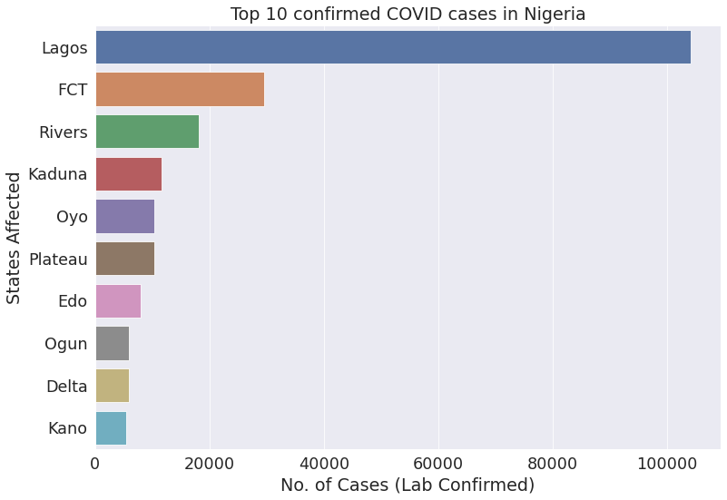
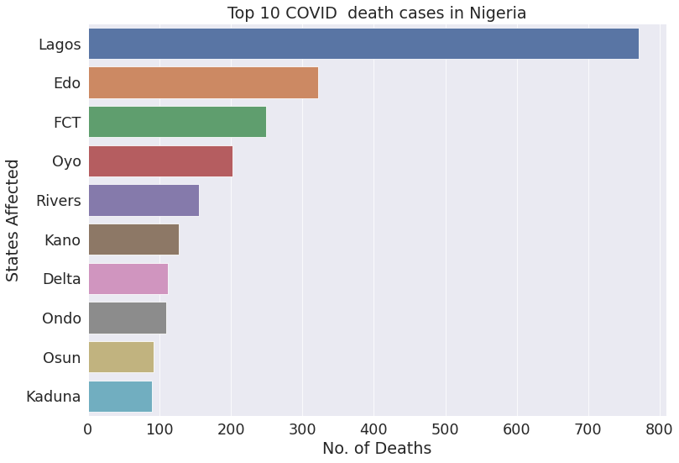

Slide 4
Infection AND DEATH RATE
22nd December, 2021 holds the highest number of infections with 6158 new COVID cases in Nigeria.
29th August, 2021 holds the highest number of deaths with 93 deaths in a single day in Nigeria.
The elderly are by far more likely to require acute care after infection

Slide 5
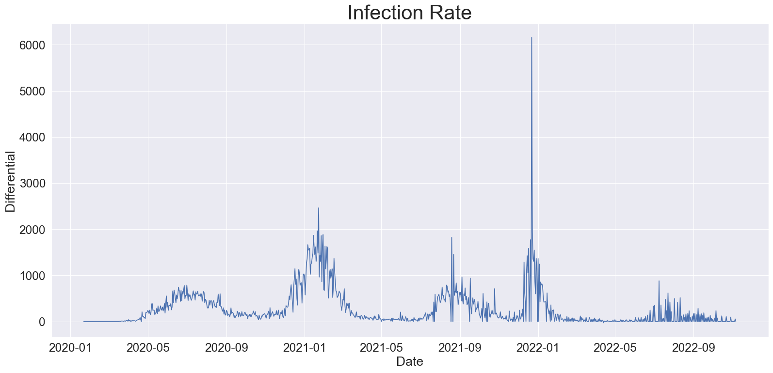
DAILY INFECTION RATE

Slide 6
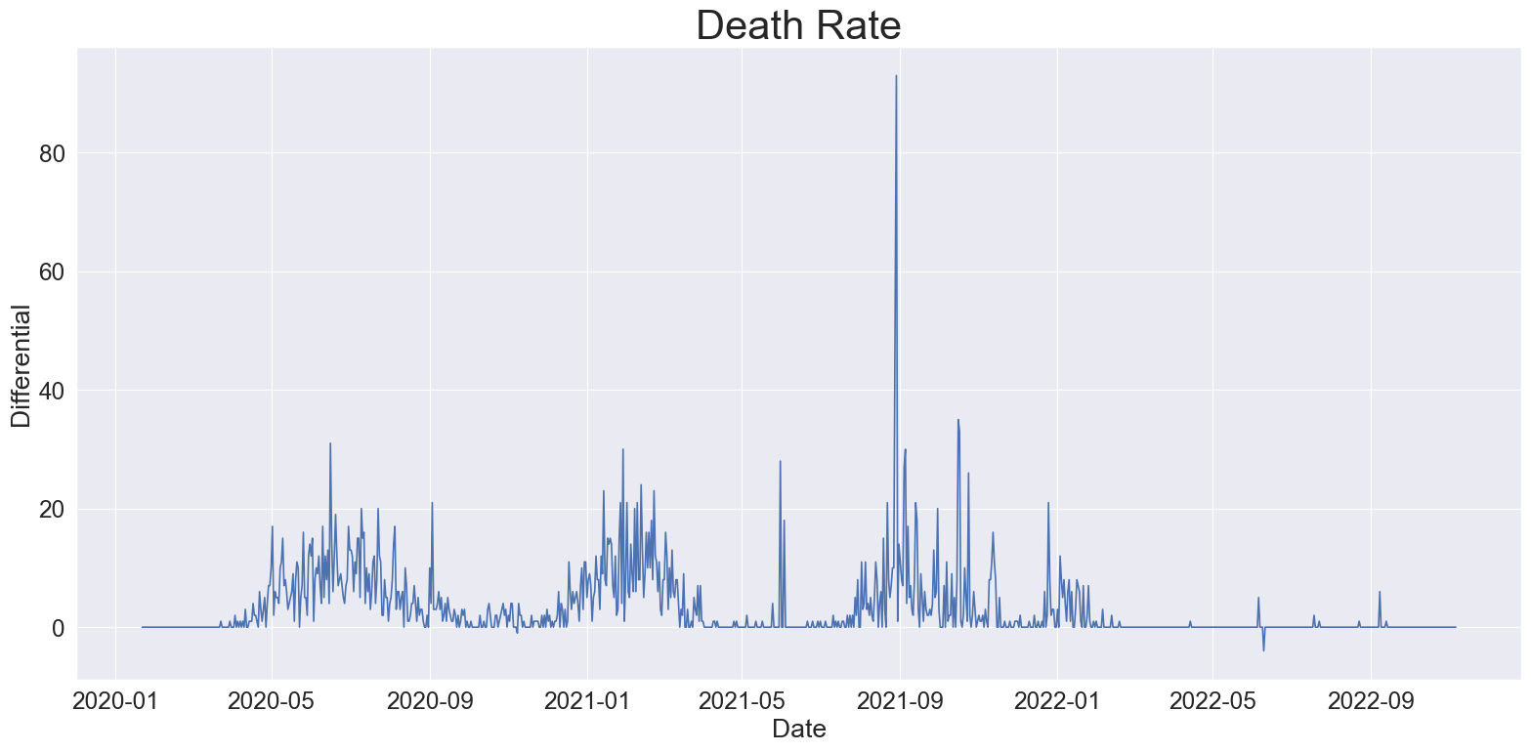
Death rate

Slide 7
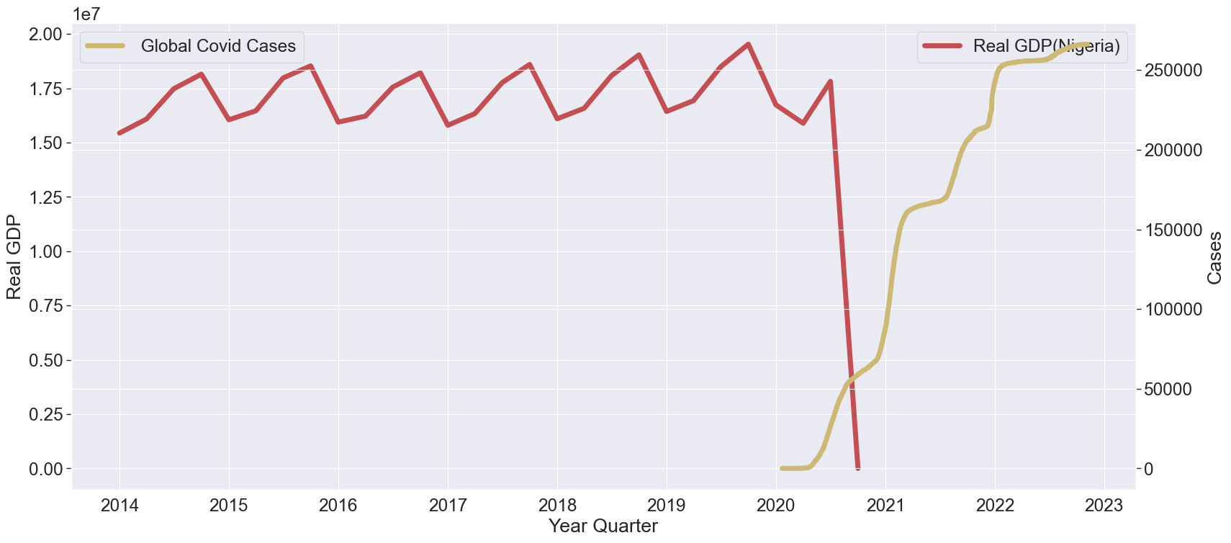
REAL GDP VS COVID EMERGENCE
The emergence of the pandemic coincides sharply with the fall of the Nigerian Real GDP

Slide 8
CONCLUSION
Lagos has the highest COVID Infections and deaths
22nd December, 2021 had the highest number of daily infections with a record of 6158 cases.
The GDP declined with the emergence of the pandemic
The vulnerability index by itself is not a good predictor of infection volume
The elderly are by far more likely to require acute care after infection
Higher population density regions have more infections
Kogi suffered the least damage from COVID with 5 confirmed cases

